Slide 1
Object Oriented Concepts
• Class & Object
• Access Specifier

Slide 2
Object-Oriented Programming
Object means a real-world entity such as a pen, chair, table, computer, watch, etc.
Object-Oriented Programming is a methodology or
paradigm to design a program using classes and objects.
It simplifies software development and maintenance by providing some concepts:
Key concepts of object-oriented programming are:
Abstraction
Encapsulation
Inheritance
Polymorphism

Slide 3
Abstraction
Abstraction is the process of identifying the key aspects of an entity and ignoring the rest.
Only those aspects are selected that are important to the current problem scenario.
Hiding internal details and showing functionality is known as abstraction.
For example phone call, we don't know the internal processing.

Slide 4
Encapsulation
Encapsulation is a mechanism used to hide the data,
internal structure and implementation details of an object.
All interaction with the object is through public interface of operations.
The user knows only about the interface;
any changes to the implementation does not affect the user.

Slide 5
Class
Class is used to defines a new data type.
Once we defined, this new data type can be used to create objects of that type.
Thus, we can say that a class is a template for an object, and an object is an instance of a class. A class in Java contains methods, fields, constructors, blocks, and interfaces.

Slide 6
Class
A class is a user defined blueprint or prototype from which objects are created.
It represents the set of properties or methods that are common to all objects of one type.
Class includes data members, methods, constructors etc…
E.g. Student,Employee,Customer,Account etc..

Slide 7
Object
The Object is an entity that has state and behavior.
The object is an instance of a class and an object is a real-world entity.
To access the members which are defined in the class you need to create an object.
for example: a chair, pen, table, bike, book, etc are the example of Object.

Slide 8
Object Creation
We can create an object with the help of a new operator.
The new operator is used to dynamically allocates memory for an object and returns a reference to it.
The new operator also invokes the class constructor.
e.g. Box obj = new Box();
Here we can create an object of Box class and obj is a reference to an object of type Box.

Slide 9
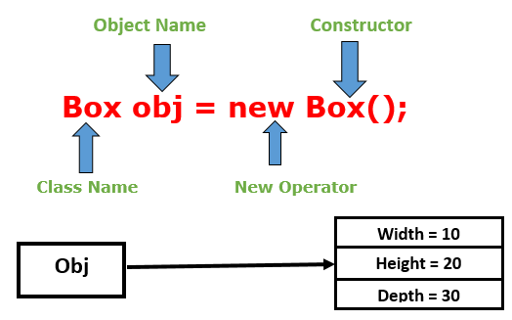

Slide 10
Objects are created from the new keyword in Java.
Every time you do something like
ClassName objectName = new ClassName();
JVM allocates the necessary memory in the Heap Area to create this object, once this memory is allocated it holds the reference to this memory through some variable which is objectName here.
All object instances and arrays are stored in a heap.

Slide 11
Constructor
Constructor
is a special method having
same name as the class name
no explicit return type not even void
may be parameterized or parameter less.
Parameterized constructor is used init state of the object.
If a class does not explicitly declare any constr , the Java compiler automatically provides a no-argument constructor, called the default constructor.
This default constructor implicitly calls the super class's no-argument constructor

Slide 12
Constructor
A constructor is used to initialize a newly created object.
It is implicitly invoked just after the memory is allocated for the object using ‘new’ keyword.
It is a special method with same name as it’s class name.
No return type for constructor. Not even void.
A constructor without input parameter is default constructor.
Constructor can be overloaded.

Slide 13
this keyword
1. To unhide , instance variables from method local variables.(to resolve the conflict)
eg : this.name=name;
2. To invoke the constructor , from another overloaded constructor in the same class.(constructor chaining , to avoid duplication)

Slide 14
this reference
Every class member gets a hidden parameter: the ‘this’ reference.
‘this’ is a keyword in Java.
‘this’ points to the current object.
‘this’ always holds address of an object which invokes the member function.
Why ‘this’?
access current object.
call the constructor of the same class.//constructor chaining
remove shadowing of instance fields.

Slide 15
this reference
public MyDate()
{
this(20);
}
public MyDate(int dd)
{
this.dd=dd;
}
//In main
MyDate m=new MyDate();
call the constructor of the same class
public MyDate(int dd,int mm,int yy)
{
this.dd=dd;
this.mm=mm;
this.yy=yy;
}
remove shadowing of instance fields

Slide 16
public MyDate(int dd,int mm,int yy)
{
this.dd=dd;
this.mm=mm;
this.yy=yy;
}

Slide 17
Variables in Java
Class Variables
Copy created per class
static variables
Instance Variables
Copy created per instance of the class.
Local Variable
Occur within a method and blocks
Copy created per method call
If used ,must be initialized or compiler complains

Slide 18
Getters And Setters Methods
Accessor /getters methods merely access instance fields/variables.
e.g. getXXX() methods
Mutator /setters methods actually change contents of instance fields.
e.g. setXXX(…) methods
class MyDate
{
private int day,month,year;
public void setDay (int d)
{
day=d;
}
public int getDay()
{
return day;
}
}

Slide 19
static Variable
Some characteristics or behaviors belong to the class rather than a specific instance
interestRate,calculateInterest method for a savingsAccount class.
count variable in Employee to count the number of objects.
Such data members are static for all instances.
Change in static variable value affects all instances.

Slide 20
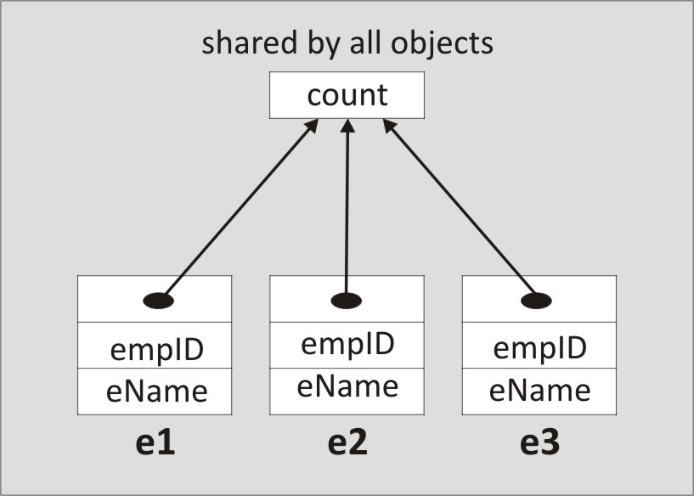
static Variables in Memory
Only single copy exists

Slide 21
static Method
static method can access static data members only.
static method is invoked using class name.
<class name>.<method name>()
Reference ‘this’ is never passed to a static method.

Slide 22
static Method
public class Employee
{
private static int count;
public static int showCount()
{
return count;
}
}
public static void main(String args[])
{
int numberOfEmployees= Employee.showCount();
System.out.println(numberOfEmployees);
}

Slide 23
public static void main
main() is static method and called before instantiation of the class.
Since it is static, it is automatically invoked by the startup code.
It is the entry point of a class.
Loader will load the class and search for main method to enter into class, so main()is declared as static.
So, ClassName.main(…)

Slide 24
static initialization blocks
Arbitrary blocks of code.
Executed before main() when class is loaded.
Used for initializing static variables.
A class can have more than one static blocks.
If more than one static blocks exists in a program then called in the order they appear in the source code.
static
{
//manipulation of static variables
}

